Slide 1
I
we you they
he she it
will
can
do
Does
am
are
is
have has
did
NOT
?
to
want
going
to
been
s
take
taken opened read closed put
take open read close put
taking opening reading closing putting
took opened read closed put
take open read close put
s
a an the this that my your his her
book

Slide 2
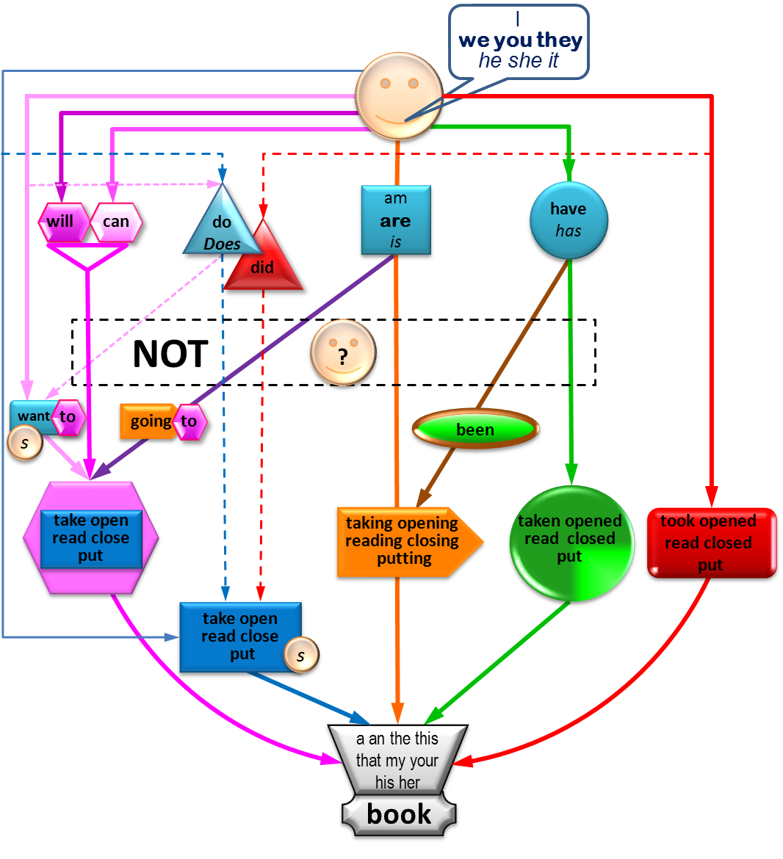
I
we you they
he she it
I want to take this book
to
want
s
take
take open read close put
a an the this that my your his her
book

Slide 3
I
we you they
he she it
will
I will take this book
take
take open read close put
a an the this that my your his her
book

Slide 4
I
we you they
he she it
am
are
is
going
to
take
I am going to take this book
take open read close put
a an the this that my your his her
book

Slide 5
I
we you they
he she it
can
I can take this book
take
take open read close put
a an the this that my your his her
book

Slide 6
I
we you they
he she it
am
are
is
I am taking this book
taking opening reading closing putting
a an the this that my your his her
book

Slide 7
I
we you they
he she it
have has
I have been taking this book for 5 seconds.
been
taking opening reading closing putting
a an the this that my your his her
book

Slide 8
I
we you they
he she it
have has
I have taken this book
taken opened read closed put
a an the this that my your his her
book

Slide 9
I
we you they
he she it
I took this book 5 minutes ago.
I took this book yesterday.
I took this book.
took opened read closed put
a an the this that my your his her
book

Slide 10
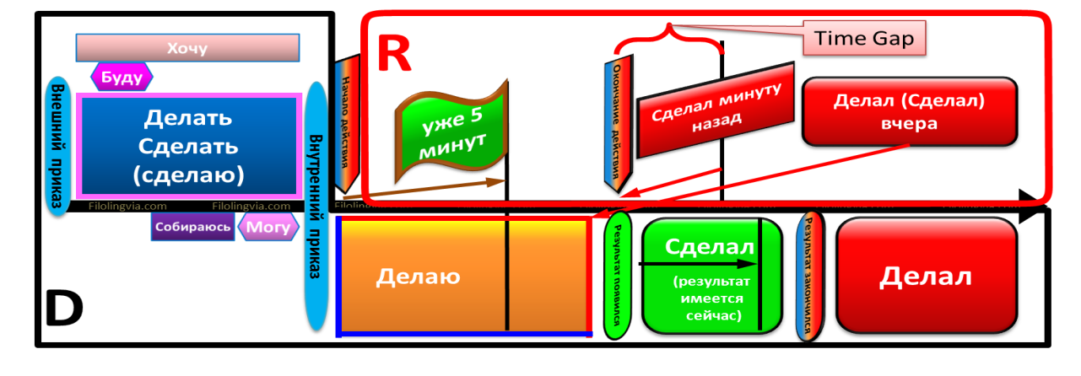
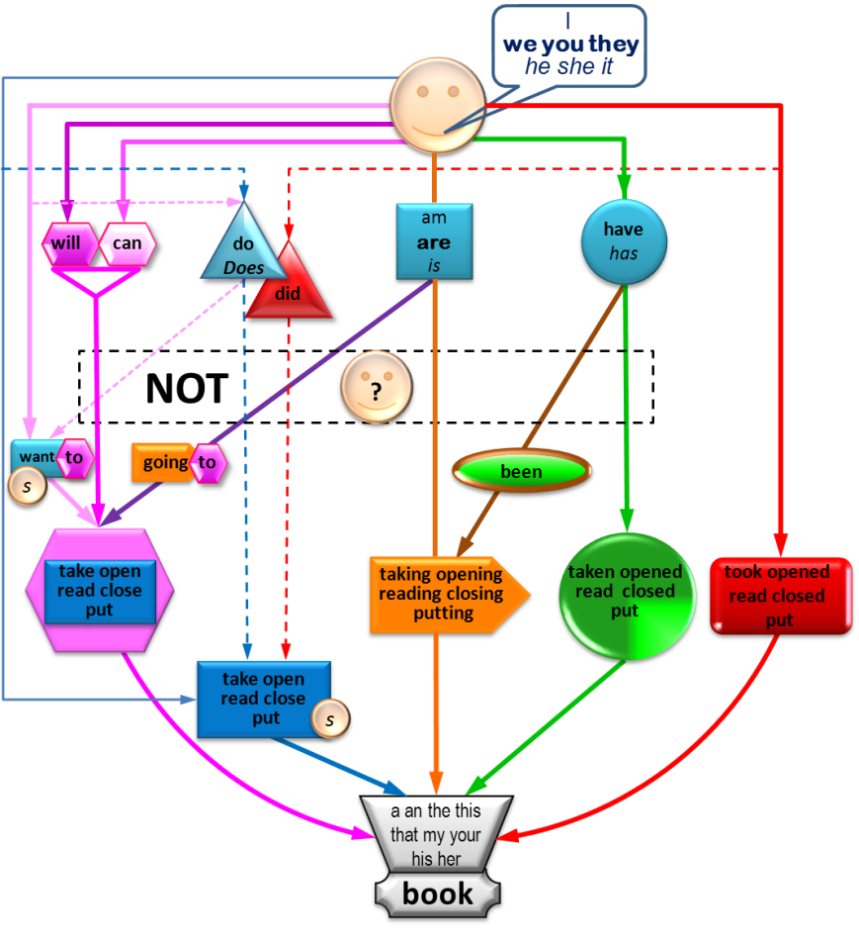
1. I want to open this book
2. I will open this book
3. I am going to open this book
4. I can open this book
5. I am opening this book
6. I have been opening this book for 5 seconds
7. I have opened this book
8. I opened this book 5 minutes ago.
9. I opened this book yesterday.
10. I opened this book.

